Slide 1
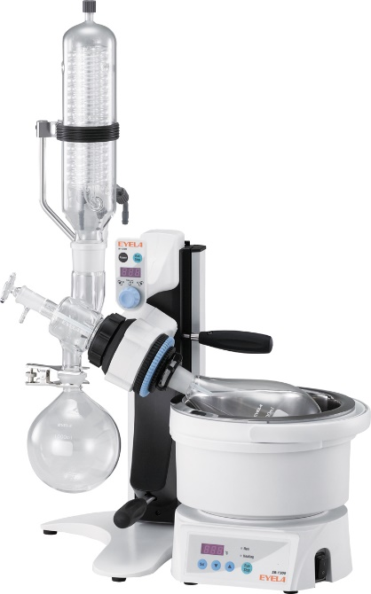
Rotary Evaporator, N-1300 (10)
Compact design !
Footprint
EYELA
313.1 in²
?
551.0 in²
?
476.7.0 in²
Other suppliers
Please call and let us know your questions.
Call 888-693-9352 or drop message in “Contact US”.

Slide 2
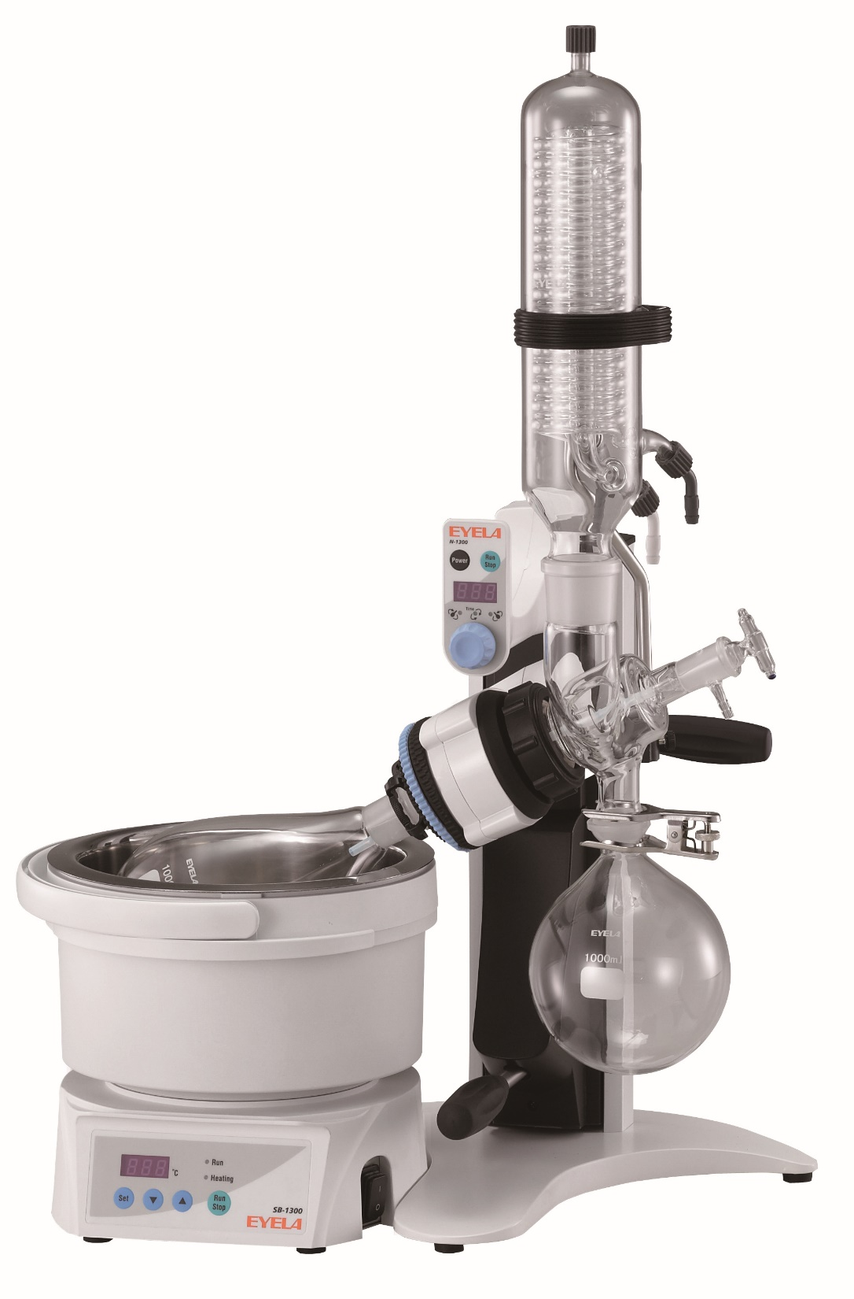
Rotary Evaporator, N-1300 (11)
Recombination
Compact design
+
Recombination mechanism
=
Fitting in limited Lab space
R
L
Top view
Glass
Bath
Bath
Glass
Please call and let us know your questions.
Call 888-693-9352 or drop message in “Contact US”.

Slide 3
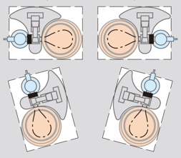
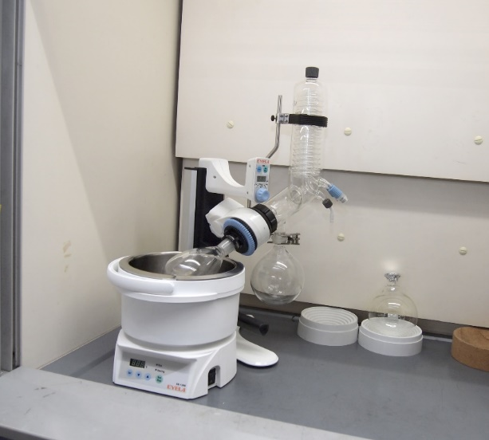
Rotary Evaporator, N-1300 (12)
Depending on setting surrounding, various lay-outs available
Top view
No dead-space !
No wasting space !
Please call and let us know your questions.
Call 888-693-9352 or drop message in “Contact US”.
in fume- hood

